Slide 1
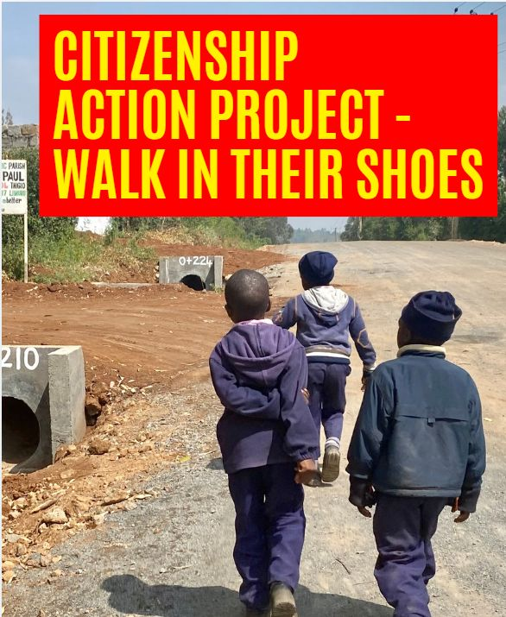

Slide 2
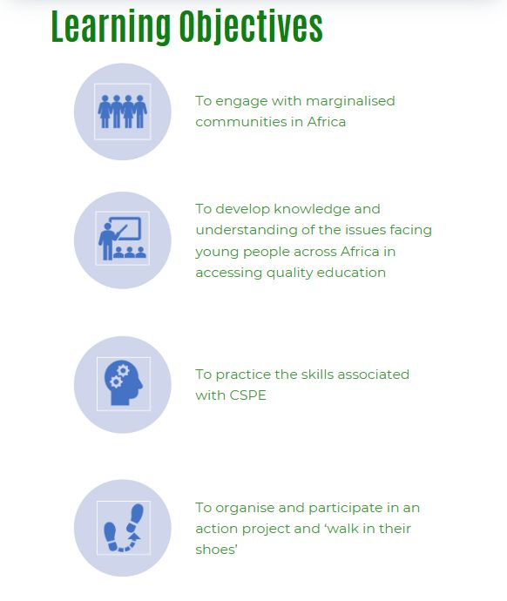
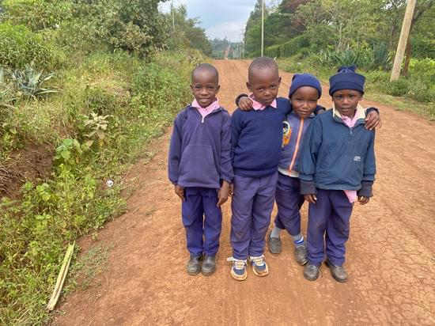

Slide 4
SUSTAINABLE DEVELOPMENT GOAL 4

Slide 5
“Education is the premise of progress, in every society, in every family. Literacy is a bridge from misery to hope. Education is a human right with immense power to transform. On its foundation rest the cornerstones of freedom, democracy, and sustainable human development.”
Kofi Annan
Former UN Secretary General and Nobel Peace Laureate

Slide 7
THE RIGHT TO EDUCATION
The Universal Declaration of Human Rights affirms that education is a fundamental human right for everyone.
Increasing access to education can improve the overall health and longevity of a society, grow economies, and even combat climate change.
But many children still do not have the opportunity to learn, especially if they live in poverty or are girls.

Slide 8
WALKING DEBATE
Nelson Mandela said “Education is the most powerful weapon which you can use to change the world”. Do you agree with this?
Education should be available and free for all children in the world
Quality education for all will mean a better world
Everyone’s right to education is recognised in Ireland
If I have no food to eat, I would not care about education
Education in Africa has nothing to do with me

Slide 9
Re-cap
Introduction to ‘Walk in their Shoes’
SDG 4 – Quality Education is one of the UN Sustainable Development Goals
SDG4 is a commitment to "ensure inclusive and equitable quality education and promote lifelong learning opportunities for all."
This goal is a pivotal driver for positive change, emphasizing the transformative power of education in fostering a sustainable and equitable world.
Walking Debate

Slide 10
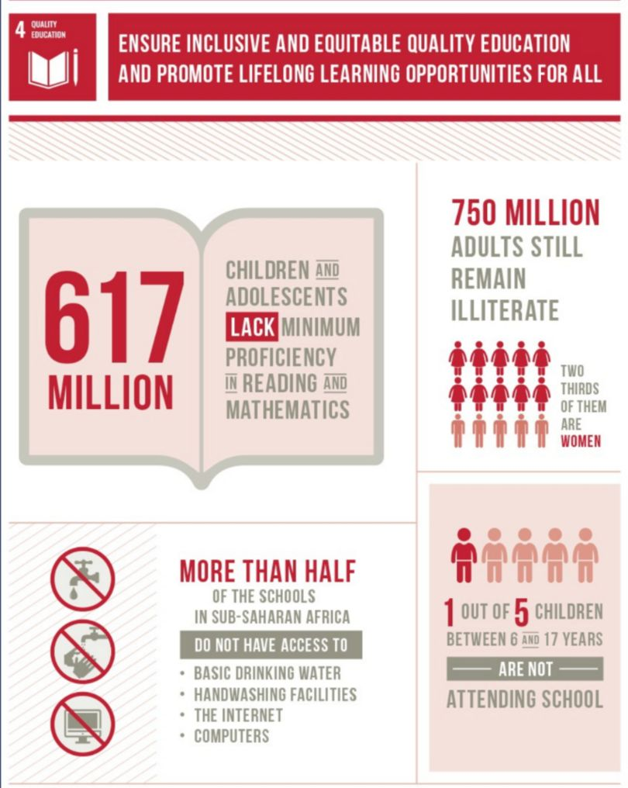
BUT…THERE ARE STILL BIG INEQUALITIES IN EDUCATION ACROSS THE WORLD

Slide 11
BARRIERS TO EDUCATION IN GLOBAL SOUTH
What kinds of things do you think might prevent children attending school in countries like Ethiopia, Ghana, Kenya and Tanzania?

Slide 12
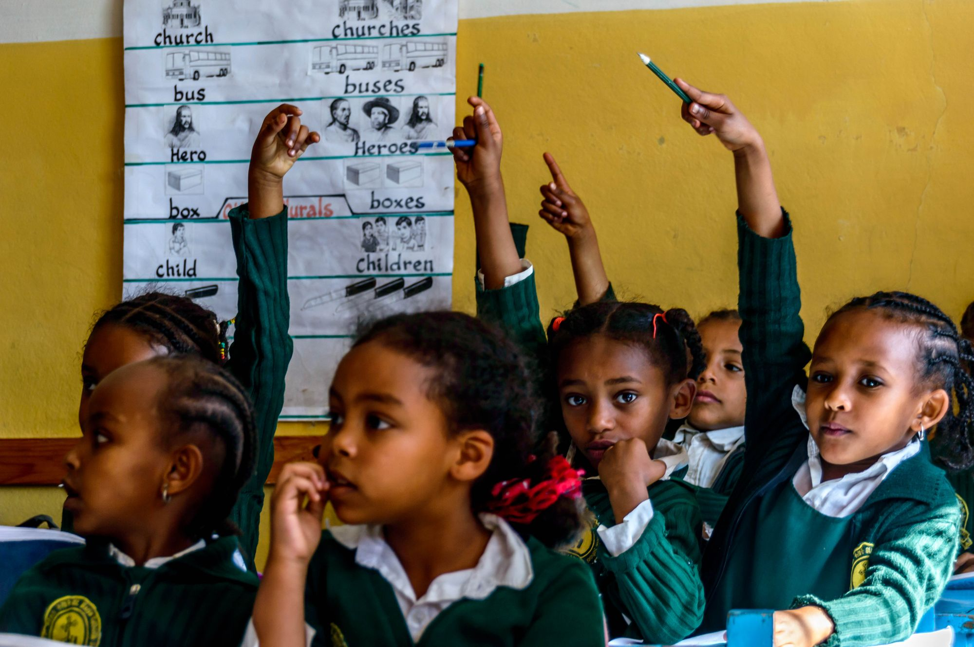
Poor government policy
Lack of toilets – especially for girls
Lack of funding for education, countries are poor
Having no teacher, or having an untrained teacher
Having no classroom
A lack of learning materials
The exclusion of children with disabilities
Being female
Living in a country in conflict or at risk of conflict
Distance from home to school
Hunger and poor nutrition
The expense of education
Harvest season
Child marriage
Being an older student and having to work from a young age
Climate change
Disease outbreaks
Violence and bullying in the classroom

Slide 13
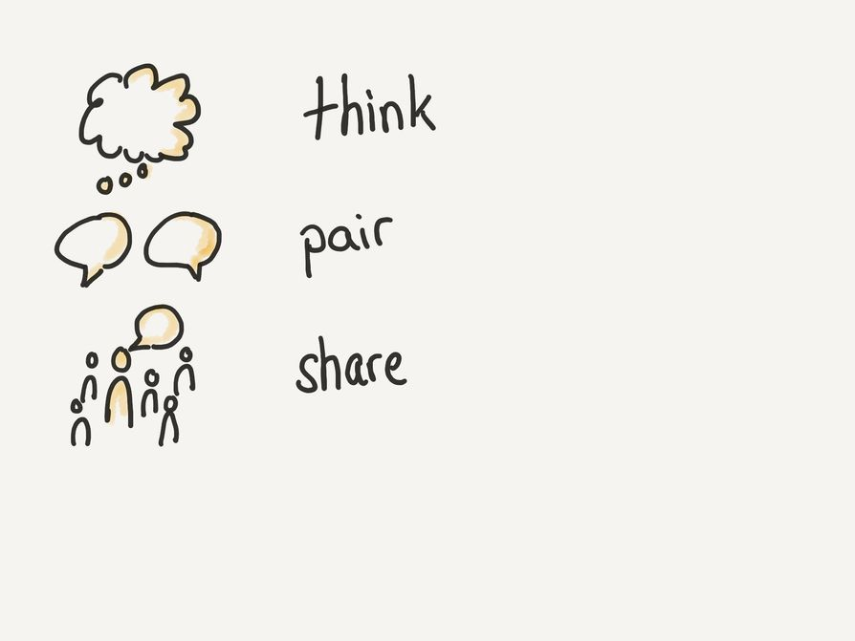
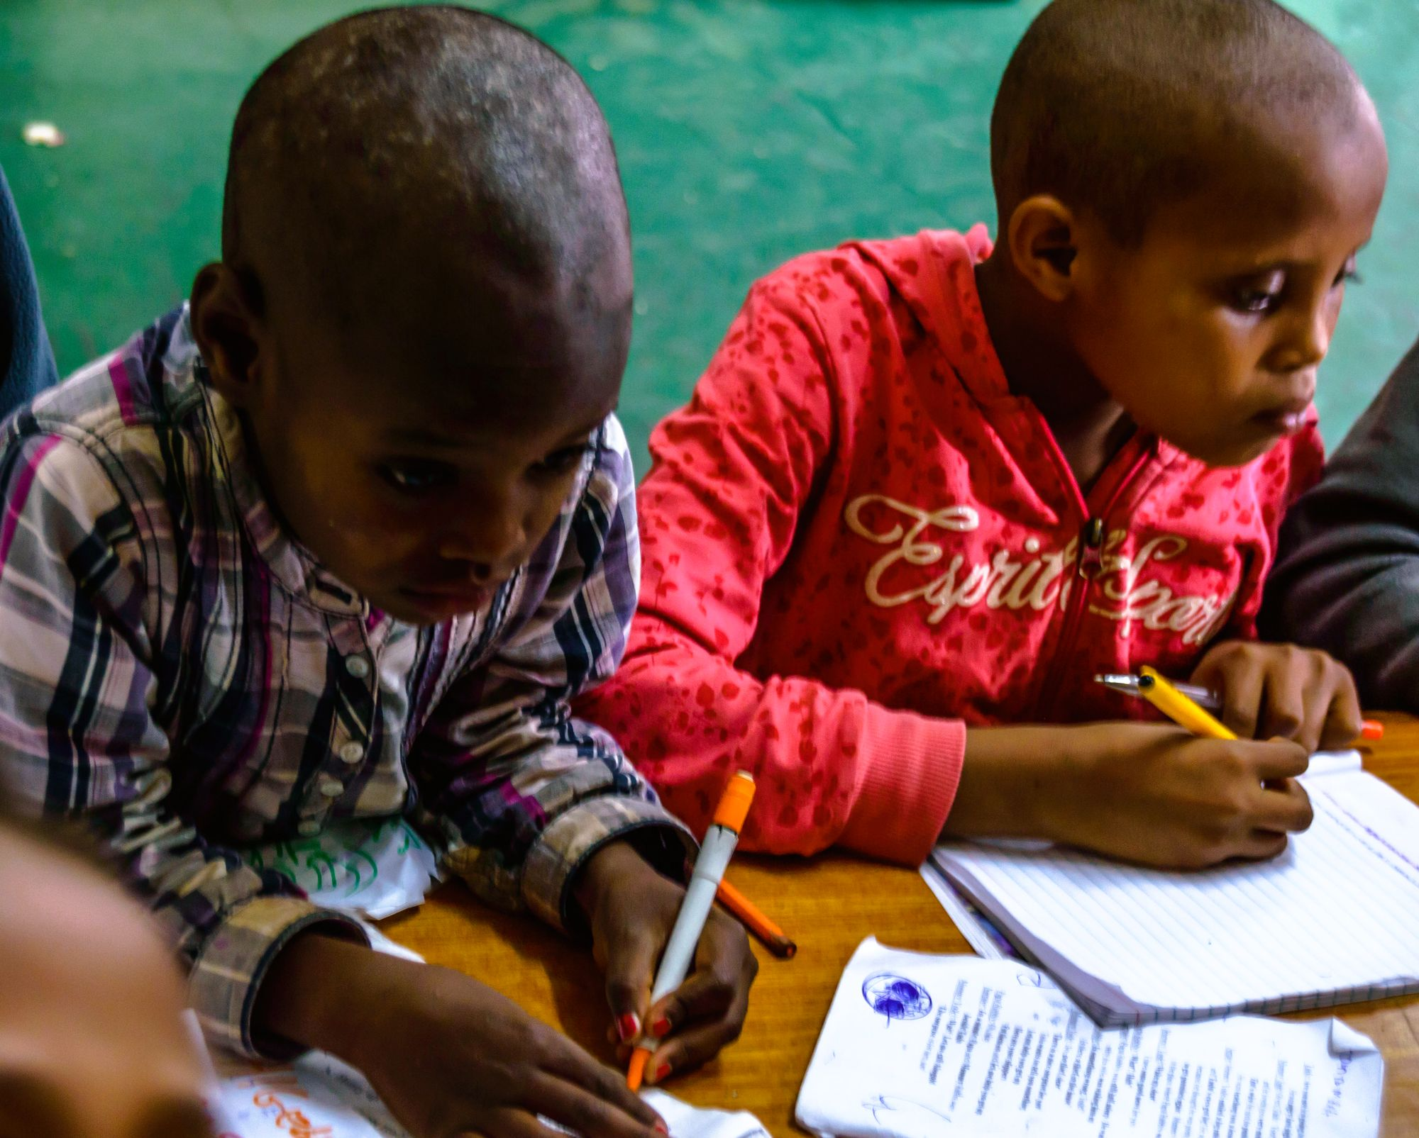
WHAT ARE THE BENEFITS OF EDUCATION?
- TO INDIVIDUALS
- TO COMMUNITIES
- TO THE WORLD

Slide 14
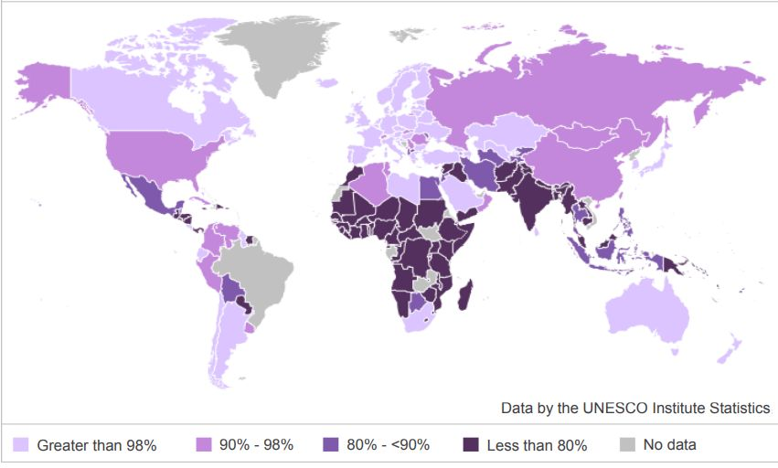

Slide 15
Questions
What does the data show about education access in Ireland and Europe?
How does this compare with other countries and continents in the world?
What does it show about education levels or access around the world?
Is there fair access to education across the world?
What impact does this inequality have on the countries?

Slide 16
Benefits of Education
Better health outcomes
Democracy and more social stability
Reduced violence/wars
Helps protect children from trafficking
Let’s children reach their full potential
Helps the environment
Reduces child labour
Helps a country’s institutions
Is a powerful agent of change
Employment opportunities
Higher income
Problem-solving skills
Boosts the economy
Giving back to the community
Poverty reduction
Reduced child marriage
Boosts self-esteem and confidence
Boosts creativity

Slide 17
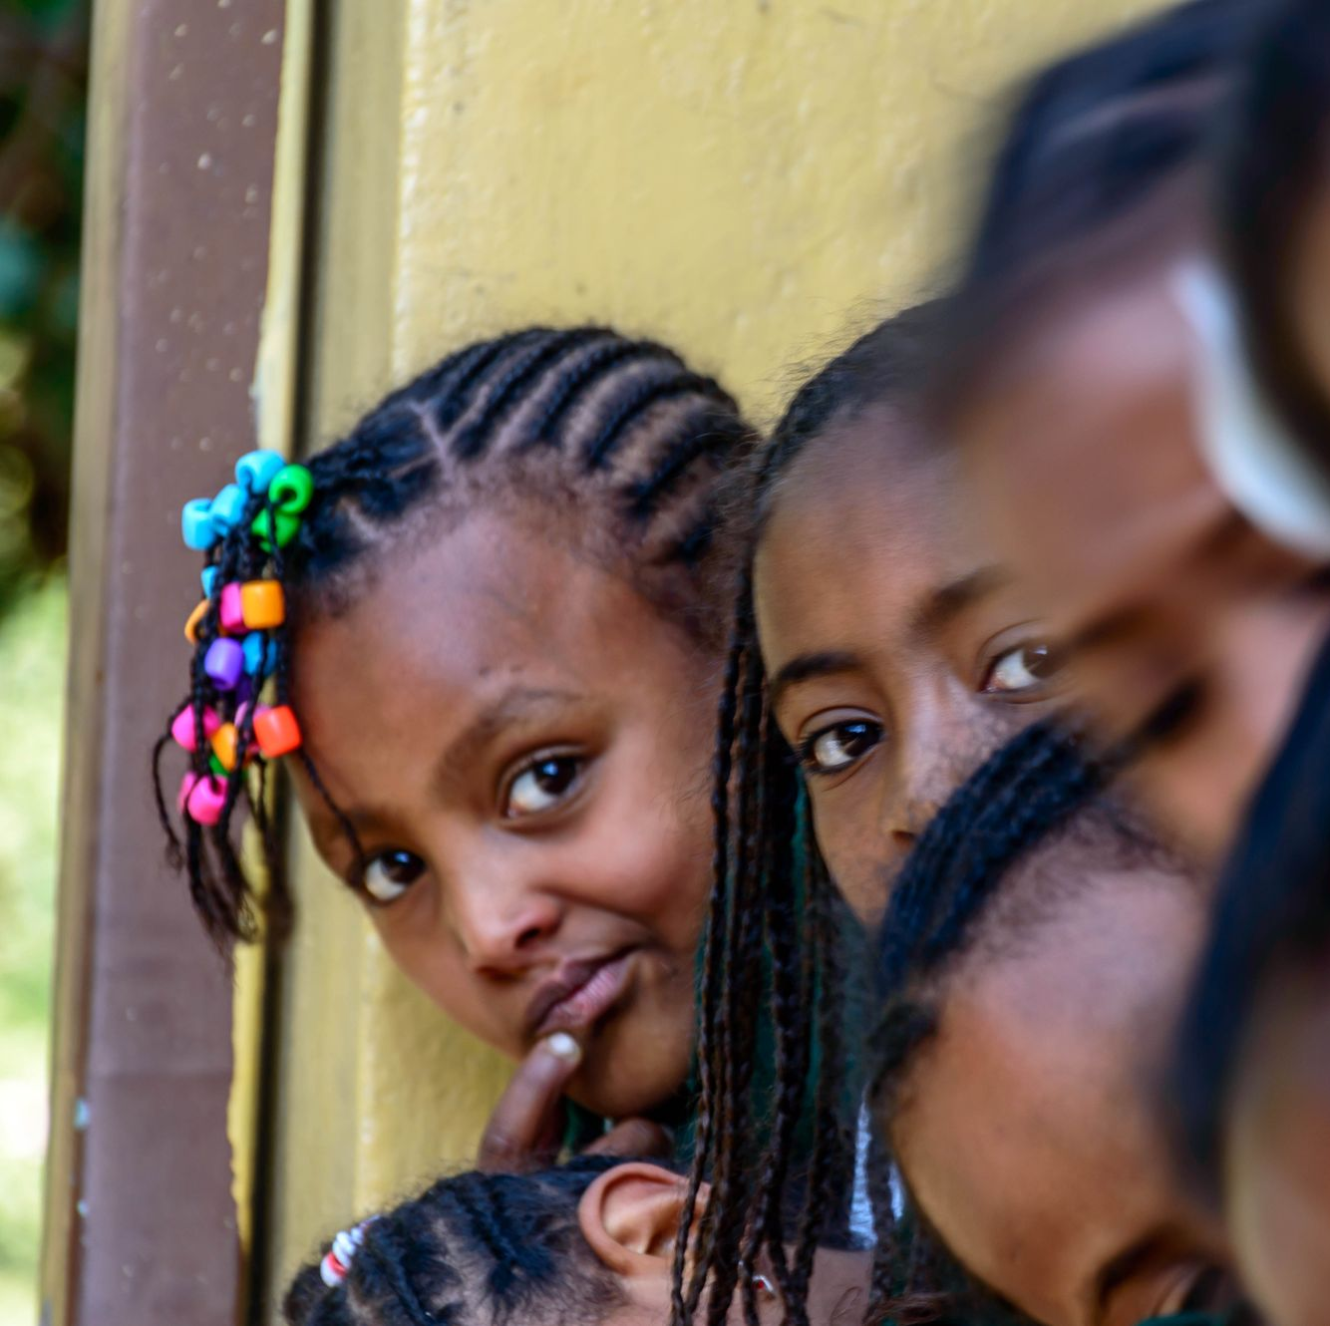
These benefits are even greater when support to education is targeted toward girls. Girls who complete their primary education tend to find better jobs, marry later and have fewer children. They are also:
half as likely to have children who suffer from malnutrition
less likely to have children who die before the age of five
less likely to turn to prostitution
less prone to be victims of sexual violence or become infected with HIV

Slide 18
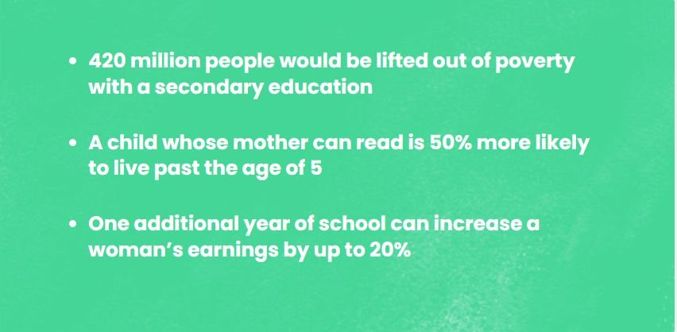
When access to education and learning grows, the ripple effects on communities and countries are remarkable

Slide 19
COMMITTEE ROLES AND RESPONSIBILITIES
PLANNING COMMITTEE
Organise the route and length - what resources will you need for this?
Organise the date
Organise how you will get to the start of the walk
Is the route safe?
Is the route interesting/pleasant?
How will people return at the end of the walk?

Slide 20
FUNDRAISING COMMITTEE
How will the walk be advertised/promoted?
How will we fundraise? Do we need any resources for this?
EDUCATION COMMITTEE
How will the class raise awareness of the issue in the school?
Can we write something for the school bulletin? Talk to classes? Design posters?

Slide 22
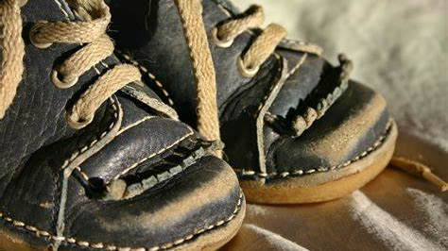
Reflection in Groups
A fact I learned
Something I found interesting
Something that surprised me
A question I’m left with
Feedback

Slide 23
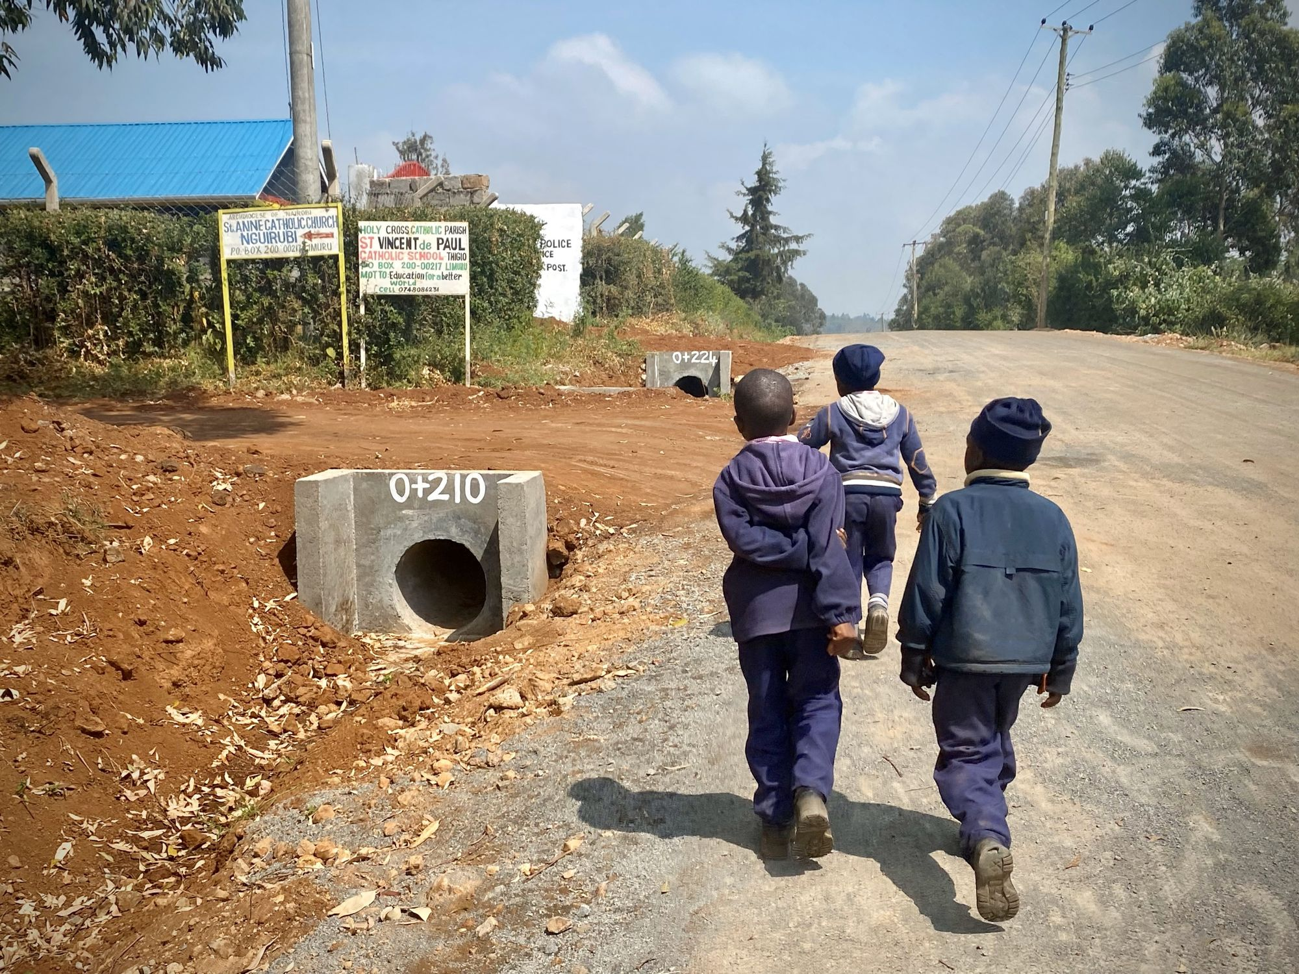
Learning Journal
How did you find the walk?
How do you think you would feel if you had to do this every day?
How does it make you feel now about your education? Has anything changed for you?
What did the walk achieve?
What new knowledge have you gained about the Global South?
Can you think of any other actions you could take?
How well did our planning sessions go?
What could I/we have done differently?

Slide 24
What’s Next…
VLM Schools Immersion Programme
This is a schools programme for 5th year students. It is a two-week long immersion trip to volunteer with one of our partner schools in the Global South. Participants stay in the community, fully immersed in the work of the Vincentian Fathers and/or Daughters of Charity.
Fundraise for VLM
As a class or as individuals you can help to fundraise for VLM partner projects. Some ideas for fundraising include -
Bake sale/coffee morning
Sponsored sleepout
Quiz night
Raffle

